Slide 1
Class Size Law In May 2022, NY State Senator John Liu introduced Bill S9460, and in September 2022 Governor Hochul enacted Chapter 556 of the Laws of 2022 which requires the New York City school district to create a five-year class size reduction plan for all New York City K-12 community districts and high schools.

Slide 2
Chapter 556 sets forth requirements that apply only to the New York City school district, including:
new class size caps for all public K-12 community district schools
a class size reduction plan, which must be approved by the Chancellor and the respective presidents of the United Federation of Teachers (UFT) and the Council of School Supervisors and Administrators (CSA) (the unions representing New York City school district teachers and principals, respectively), and submitted as part of the Contract for Excellence
a prescribed timeline for the public process for the development, posting, and submission of the Contract for Excellence
annual reports on the status of the implementation of the class size reduction plan
penalties, in the form of reduced State funding, if adequate progress to reduce class sizes is not made

Slide 3
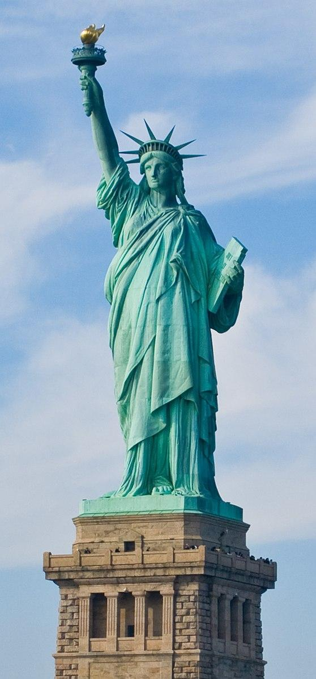
Class Size Caps
Grade Level | Caps under UFT Collective Bargaining Agreement | Caps under Chapter 556
K | 25 | 20
1-3 | 32 | 20
4-5 | 32 | 23
6-8 (Title I Schools) | 30 | 23
6-8 (non- Title I Schools) | 33 | 23
9-12 | 34 | 25
Performing Groups & PE in grades 6- 12 | 50 | 40

Slide 4
Classes Not Subject to Class Size Targets
Type of Class/Exemption | Requirements
Space Exemption | Approval by Chancellor and UFT and CSA presidents NYCPS must demonstrate capital budget is aligned to resolve exemption
Over-Enrolled Students Exemption | Approval by Chancellor and UFT and CSA presidents
License Area Shortage* Exemption | Approval by Chancellor and UFT and CSA presidents
Severe Economic Distress Exemption | Approval by Chancellor and UFT and CSA presidents
Elective & Specialty Classes | UFT may negotiate higher class sizes than targets if majority of school staff approve increase
*This refers to areas where there are an insufficient number of teachers in a certain license area (e.g., bilingual math).

Slide 5
Class Size Plan
The following list is comprised of actions which the Chancellor, UFT, and CSA intend to undertake in the coming year to remain in compliance with the law.
Community Engagement
School Needs Assessment, Data Enhancements & Analysis for Implementation
Defining Performing Groups for Compliance with the Law
Capital Planning
Adding Funding into School Budgets
Continued Labor Partner Engagement
Superintendent Engagement
School Community Engagement
Note that the law requires that this plan prioritize schools serving populations of students with higher poverty levels.

Slide 6
School Compliance Actions
Rebalance classes
Repurpose space
Maximize teacher programming
Fully program existing instructional space
Reallocate funding
Use new funding to increase class size compliance
Add sixth period coverages and pro rata courses
Utilize multi-session programming
Consider shared instructional models in co-located schools
Consider all individuals at the school level who hold a teaching license to teach
Utilize virtual learning as a strategy
Note in SY 24-25, principals were not required to limit student enrollment to meet targets.

Slide 7
The five-year phase-in requires 20% of NYC classes to comply with the limitations by school year 2023-2024, with additional 20% each year until 100% of NYC classes are in compliance by school year 2027-2028.
Class Size Timeline
School Year | Required Compliance Rate
2023-2024 | 20%
2024-2025 | 40%
2025-2026 | 60%
2026-2027 | 80%
2027-2028 | 100%

Slide 8
Sources
State of New York Bill S9460
https://www.nysenate.gov/legislation/bills/2021/S9460
2. Liu hails signing of bill to finally reduce class sizes in NYC public schools
https://www.nysenate.gov/newsroom/press-releases/2022/john-liu/liu-hails-signing-bill-finally-reduce-class-sizes-nyc-public
3. FY 2025 Class Size Reduction Plan for NYC Public Schools
chttps://drive.google.com/file/d/1XKUYGUIlwzYp7prCQqeatPvcJYL7oFTe/view

